Slide 1
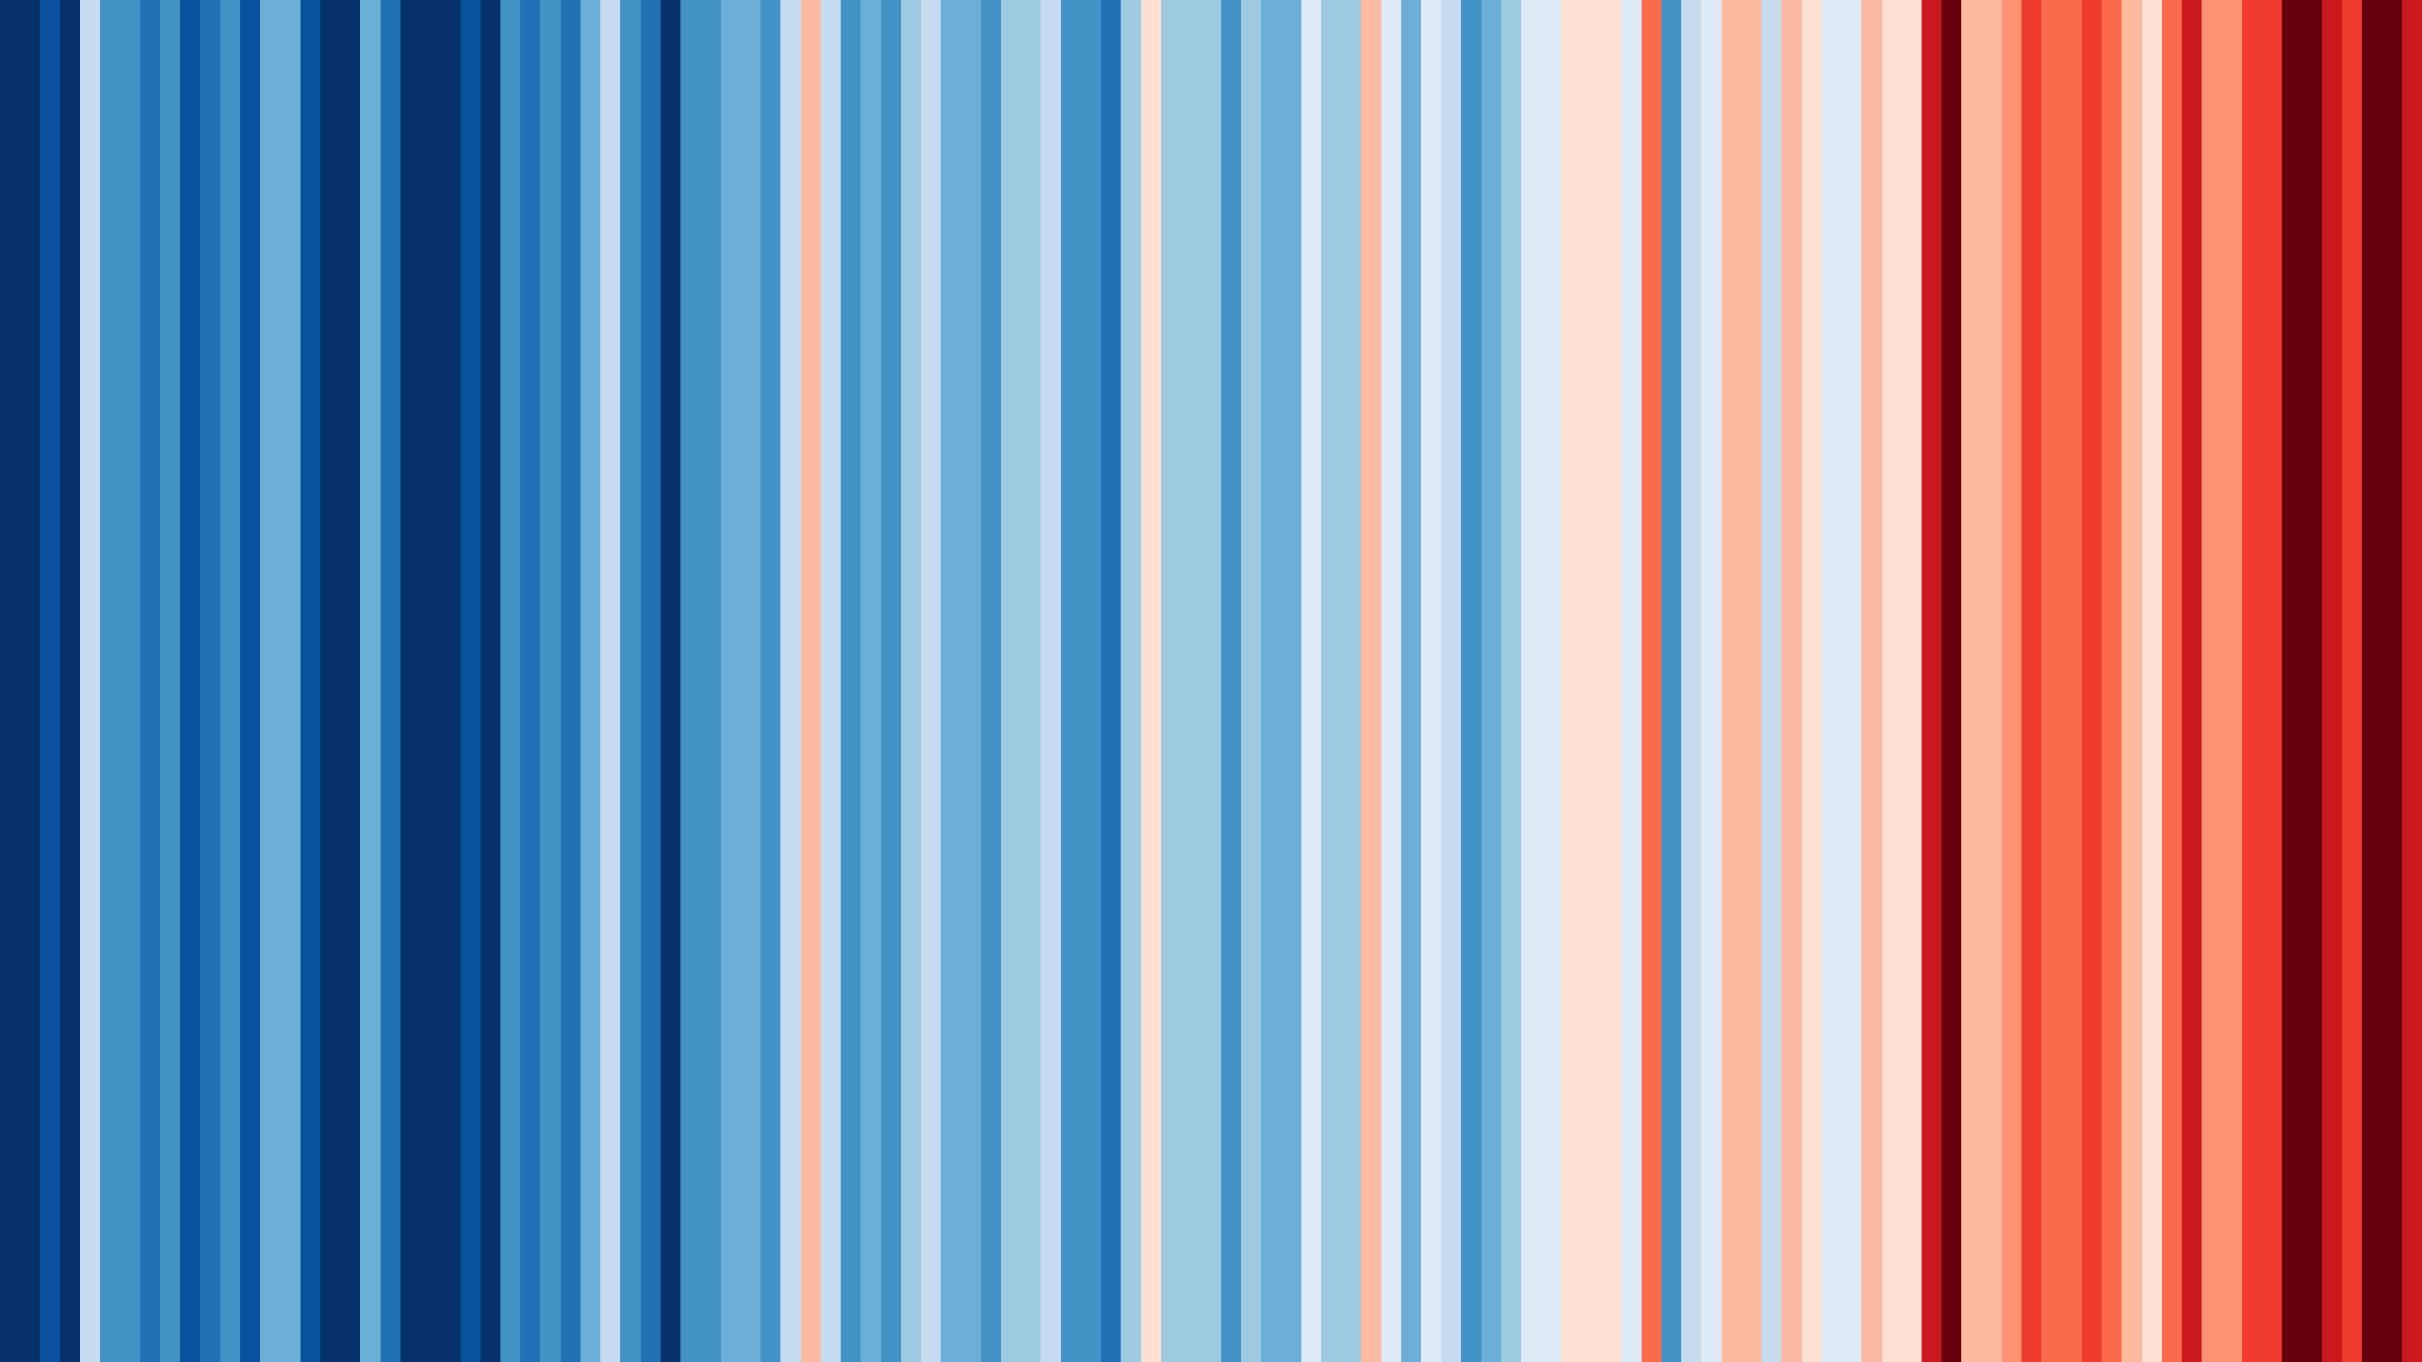
Critique of Data Visualization
https://showyourstripes.info/s/asia/singapore
Ong Kian Eng
Notes:
Background
We have spent some time discussing the visualization model. What (data) - why (task) - how (idiom)
We have also looked at viz validation from a 4-step framework. The right domain - data - idiom - tech.
It is time to take some time to think about the heart of these issues a little more deeply.
Critique: Data and Idioms
It is harder to critique domain issues unless you've worked on the visualization.
Similarly, it is harder to critique tech issues unless you've worked on it.
However, when it comes to the idiom and to an extent data, it is far easier for us to critique choices.
You can find visualization examples on the Data Is Beautiful reddit or any number of blogs.
Assignment
Bad visualizations can arise from data issues - badly chosen data scale, missing / inaccurate data, etc.
Another pitfall is choosing the wrong idiom / putting it together badly - too many color channels, chartjunk, etc.
Find 2 visualization examples, and dissect it critically on what you feel is wrong.
Comment on the data and idiom issues. Can be for both visualizations or one each.
Also comment on how the visualizations can be improved.
More details
This assignment is to get you to think about all the theory that we've learnt so far in this course.
Beyond the tech execution, we also arm ourselves with tools to think critically about visualizations. This exercise will help you think and frame your project.
Not a writing essay assignment, so short paragraphs or bullet points are fine.
For this module, I will likely ask you to present your critiques to the class after submissions are in.

Slide 2
Why this topic for data visualization?
Topic of focus: Climate Change
Many statistics are churned out and displayed in various forms from this area of research
Visualization of climate change data plays an important role in
presenting accurate information / prediction
communicating scientific insights to different communities (scientific and general public)
shaping public’s opinions and actions
influencing policies
Notes:
https://www.nytimes.com/interactive/2022/01/11/climate/record-temperatures-map-2021.html
https://www.nytimes.com/2022/03/10/learning/whats-going-on-in-this-graph-march-16-2022.html
file:///C:/Users/KE/Desktop/vis/IPCC_AR6_WGI_Full_Report_smaller.pdf
https://www.frontiersin.org/articles/10.3389/fmars.2021.642372/full#B22
https://www.visualcapitalist.com/sustainable-development-goals/
Other problematic visualizations:
https://www.visualcapitalist.com/worlds-ultra-wealthy-population-live/
https://www.visualcapitalist.com/mapped-global-happiness-levels-in-2022/

Slide 3
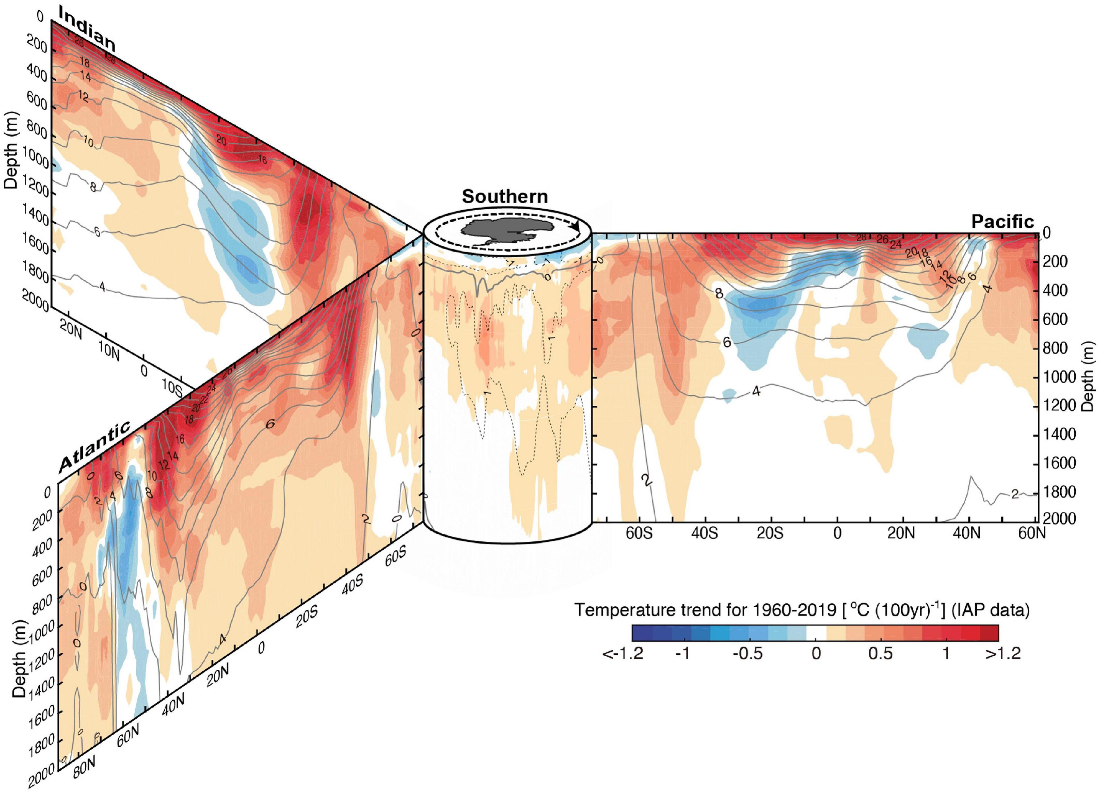
Visualization 1: Trend of ocean temperature
This static visualization aims to show the ocean temperature trends (°C per century) from the sea surface to 2,000 m depth in the period 1960–2019 (60-year ordinary least-squares linear trend).
Zonal mean sections in each ocean basin are organized around the Southern Ocean (south of 60°S) in the center.
Black contours show associated climatological mean temperature with intervals of 2°C (in Southern Ocean), while 1°C intervals are in dashed contours).
Exploratory analysis:
What is extent of temperature change for different oceans in the world for the past 60 years?
https://www.frontiersin.org/articles/10.3389/fmars.2021.642372/full#B22

Slide 4
👍Plus points of Visualization I
Well-annotated legend and axes
Orientation of Southern Ocean is shown
Careful selection of divergent colour scheme to show range of temperature changes
Temperature is binned for better interpretability of results
Logical use of divergent colour scheme (Blue for colder, Red for warmer)
https://www.frontiersin.org/articles/10.3389/fmars.2021.642372/full#B22

Slide 5
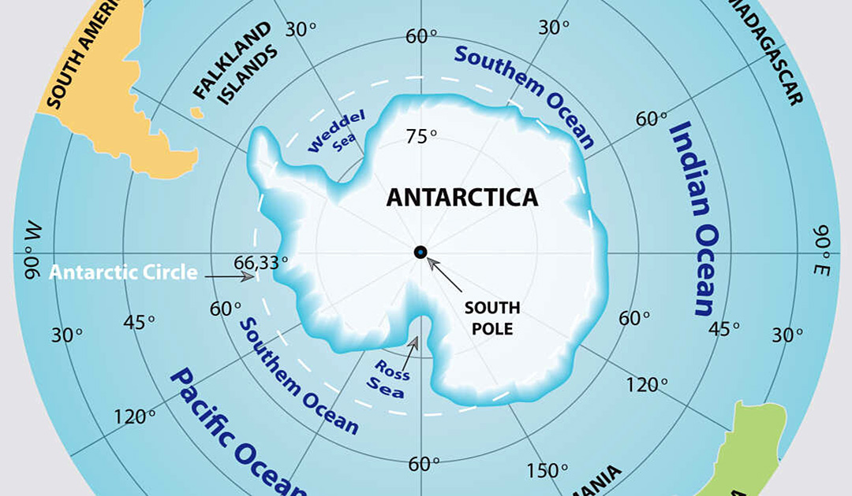
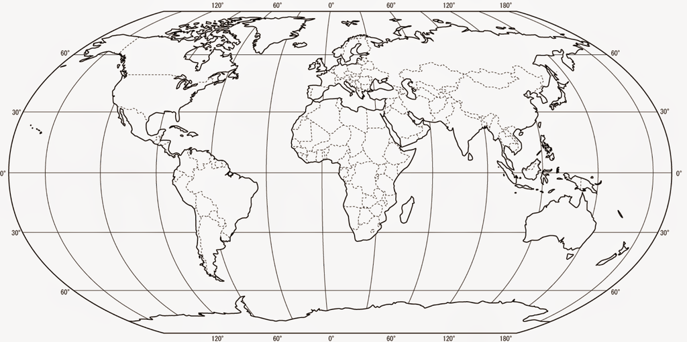
😅 Areas for improvement points for Visualization I1
Data issue
See the respective coloured arrows to see how the slice of data was obtained
How are the values determined? Are they taken at one spot (fixed longitude) at a particular depth → Incomplete data? Accurate data? Aggregated data?
Temperature changes will likely to be higher on the surface than at deeper depths
Circulation of water in the ocean may play a role in the (uneven) distribution of temperature
See next slide
Best to consider slicing the data at different depths (e.g. world ocean maps at the depth of 0m VS 2000m)
Different oceans have different depths, however this data (shallower depths) may not be reflected
Best to use a separate colour (e.g. grey) to mark out shallower depth
Latitude
Latitude
Latitude
60°N
Latitude
0°
60°S
180°W
0°
180°E
https://www.frontiersin.org/articles/10.3389/fmars.2021.642372/full#B22
Longitude
Notes:
The Arctic Ocean is the shallowest (mean depth 1361 m) and has significantly larger continental shelves than other oceans.
https://o.quizlet.com/gK4aWdZwNKmgBpyHY2s8kA_b.png

Slide 6
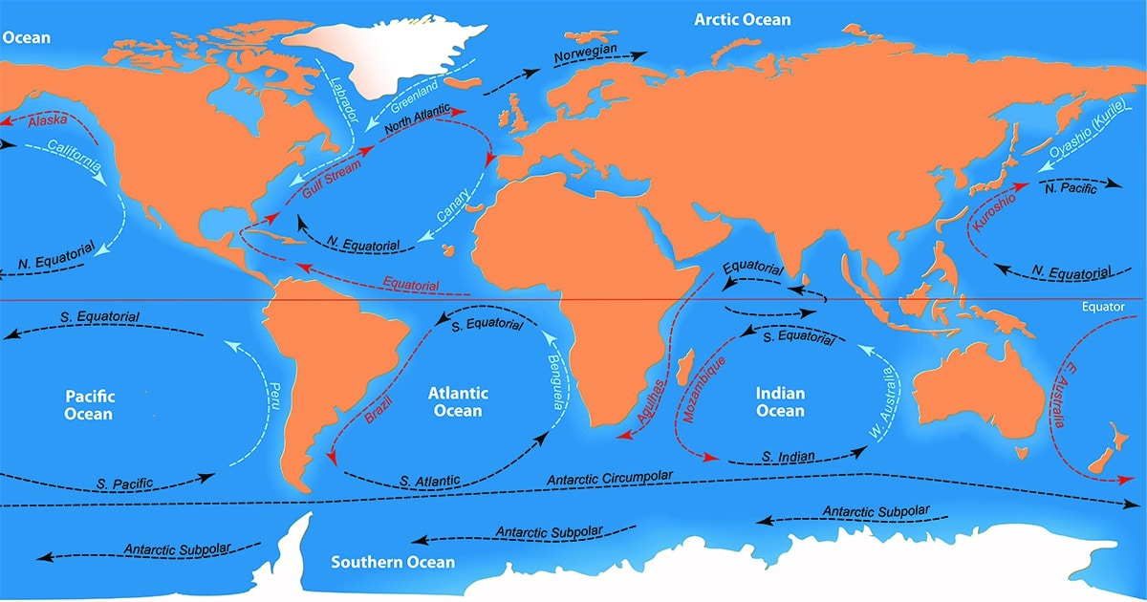
Ocean circulation
Notes:
https://mymodernmet.com/wp/wp-content/uploads/2021/06/southern-ocean-antarctica-thumbnail.jpg

Slide 7
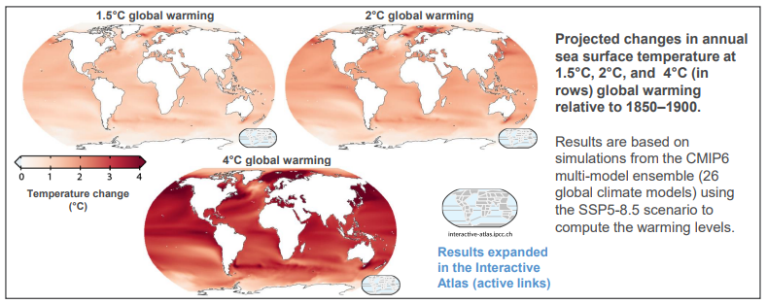
😅 Areas for improvement points for Visualization I1
Idiom issue
“3D” view → Difficulty in interpreting data
Parts of Indian ocean data (top left) is occluded
Skewed perspective of Atlantic and Indian ocean data (left) makes it hard to interpret the association between location, depth, climatological mean temperature and temperature trend → False perception of “depth” and area
Best to faceted isobaric map without distorted perspective, with inset world map shown (See sample at bottom right)
Excessive range of colour channels (19) to encode the range of temperature trend
Colours at the extreme ends cannot be distinguished (highlighted in red box) – Colour channel separability and discriminability issues
The tics (markings) showing the temperature interval does not coincide with the edge of the colour bins
Best to bin into 7 or fewer distinct intervals of values
https://www.frontiersin.org/articles/10.3389/fmars.2021.642372/full#B22
Notes:
The Arctic Ocean is the shallowest (mean depth 1361 m) and has significantly larger continental shelves than other oceans.

Slide 8
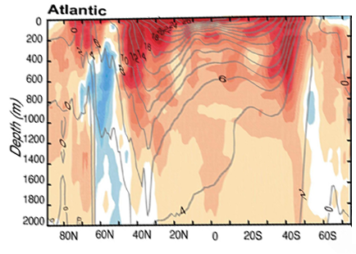
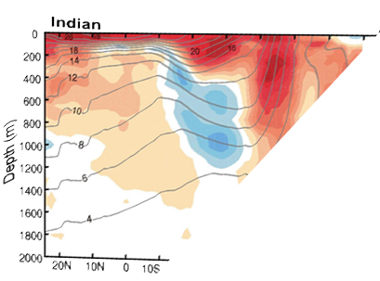
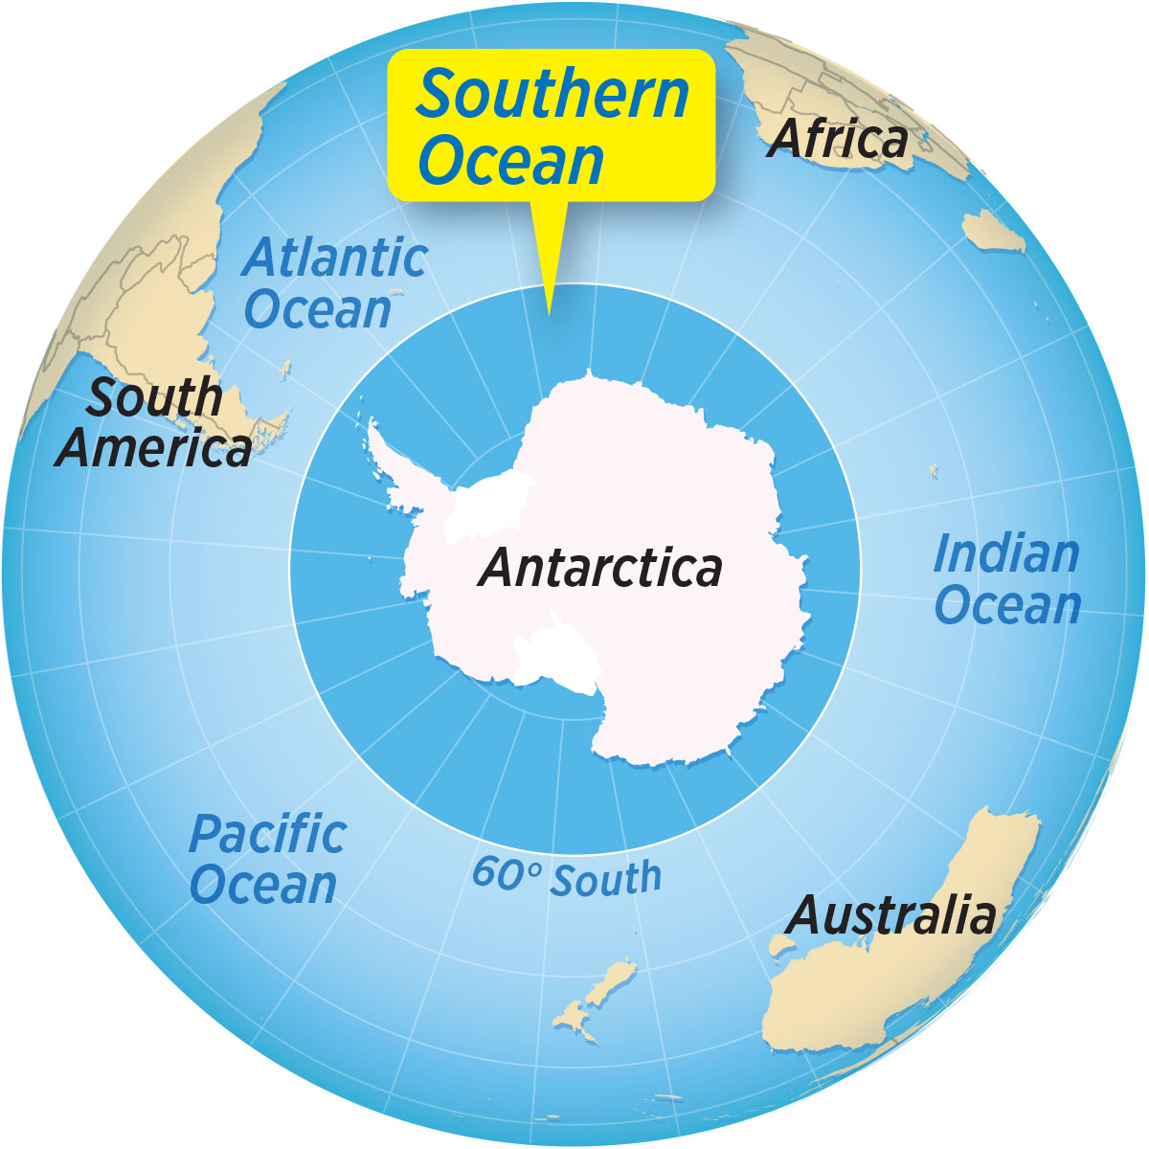
Proposed revision
Atlantic
Indian
Latitude
90°W
30°S
60°S
60°S
90°E
30°S
Latitude
Proposed revision
Latitude

Slide 9
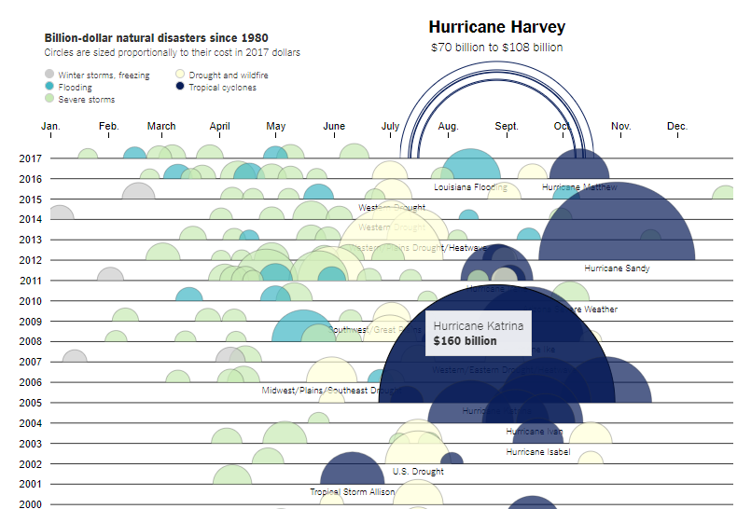
Visualization 1I: Cost of damage of Hurricane Harvey
This interactive visualization aims to highlight and compare the damage (cost) of Hurricane Harvey with other natural disasters
Exploratory analysis:
What is the extent of damage for Hurricane Harvey compared to past natural disaster?
Which disaster event costs more and when?
How are the disasters distributed across years and months?
New York Times
https://www.nytimes.com/interactive/2017/09/01/upshot/cost-of-hurricane-harvey-only-one-storm-comes-close.html

Slide 10
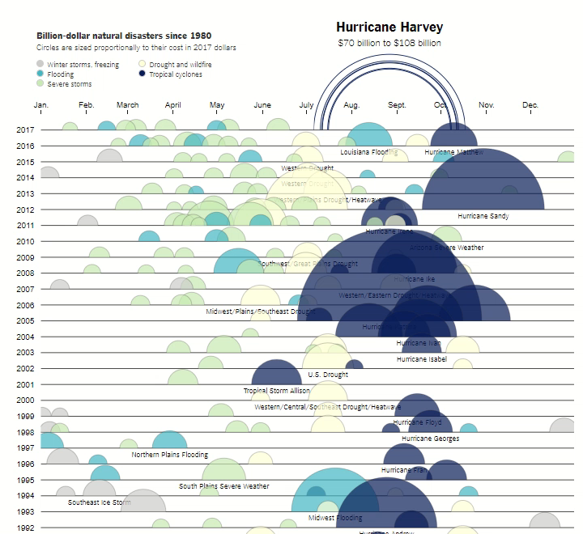
Snapshot

Slide 11
👍Plus points of Visualization I1
Clear and logical ordering of events with the latest events shown on top (nearer to Hurricane Harvey)
Show trend of disaster over years and months
Clear focus with the use of a few variables (year, month, disaster type, cost of damage) → Easier processing
Detailed cost of damage shown on hover
Address the key question on how Hurricane Harvey compares to other disasters
https://www.nytimes.com/interactive/2017/09/01/upshot/cost-of-hurricane-harvey-only-one-storm-comes-close.html

Slide 12
👍Plus points of Visualization 1I
Good use of a small number of 5 clear categories to encode different categories of natural disasters→ Easier processing
Human’s working memory of less than 7 items (5 colours of disaster events in this case [https://phys.org/news/2009-11-brain-magic.html]
Different types of natural disasters result in different types of damages, and hence cost
Logical grouping of events
Careful selection of distinctive colours (hues)
Selection of colours somewhat reflects the colours associated with the disaster
E.g. Blue with flood, Grey with winter storms / freezing
https://www.nytimes.com/interactive/2017/09/01/upshot/cost-of-hurricane-harvey-only-one-storm-comes-close.html

Slide 13
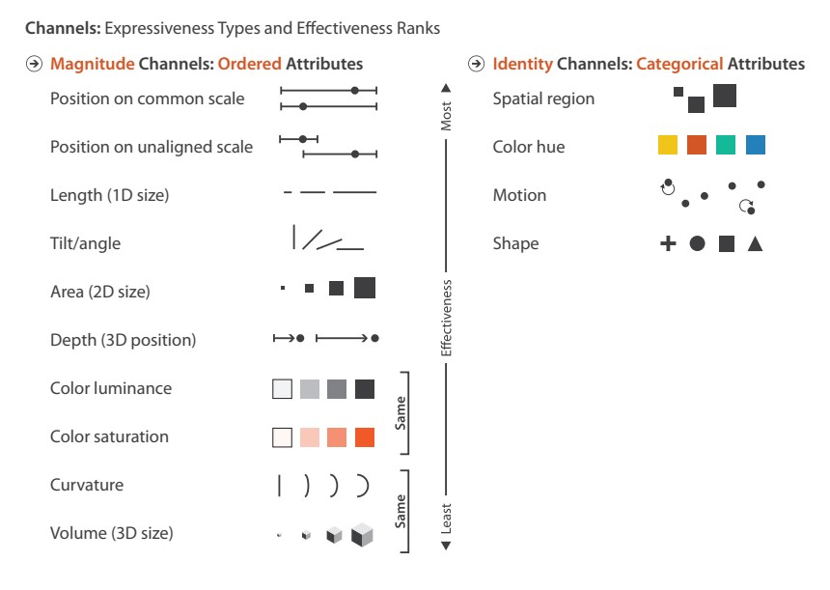
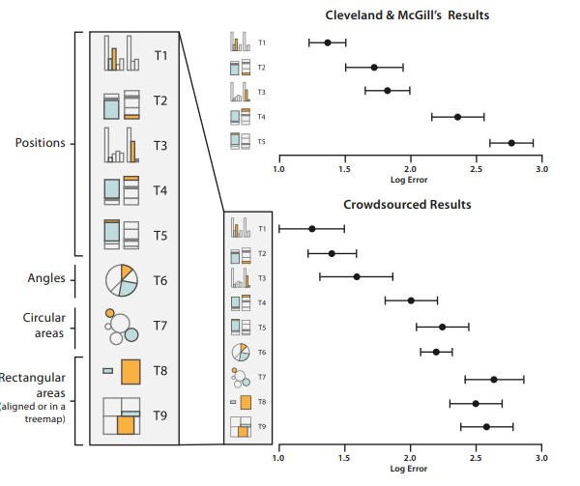
😅 Areas for improvement points for Visualization I1
Idiom issue
Use of semi-circles → Difficulty in assessing / interpreting the (relative) size of the circle (e.g. to what extent / how much more does Hurricane Katrina cost compared to Hurricane Harvey)
Humans are poor at interpreting area (Weber-Fechner Law, Cleveland and McGill Graphical Perception)
https://www.nytimes.com/interactive/2017/09/01/upshot/cost-of-hurricane-harvey-only-one-storm-comes-close.html

Slide 14
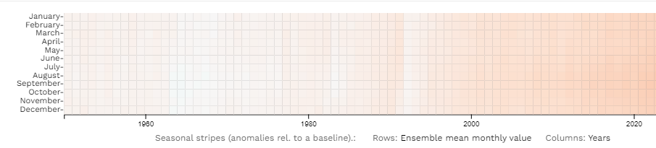
😅 Areas for improvement points for Visualization I1
Idiom issue
Semi-circles overlap with one another
Hard to interpret extent of damage if many of them overlap (dark blue tropical cyclones circles at the bottom right)
Some semi-circles in the background cannot be hovered over (i.e. blocked by the larger semi-circle in front)
May also result in confusion that the edges of the semi-circles indicate the duration of the disaster
This idiom of visualization may not be the best. Best to use faceted heatmap instead (See sample at bottom right) – one for each disaster type with shared colour scale
Multiple concentric semi-circles for Hurricane Harvey at the top does not make it intuitive to interpret the cost of damage from $70B to $108B
Animation of concentric semi-circles does not value-add to interpretation
Best to show 2 semi-circles (reflecting $70B and $108B) instead of 4
If this chart is still used, perhaps can have a legend showing the different representative sizes of semi-circles in ranked order so that easier comparison can be made
https://interactive-atlas.ipcc.ch/
https://www.nytimes.com/interactive/2017/09/01/upshot/cost-of-hurricane-harvey-only-one-storm-comes-close.html

Slide 15
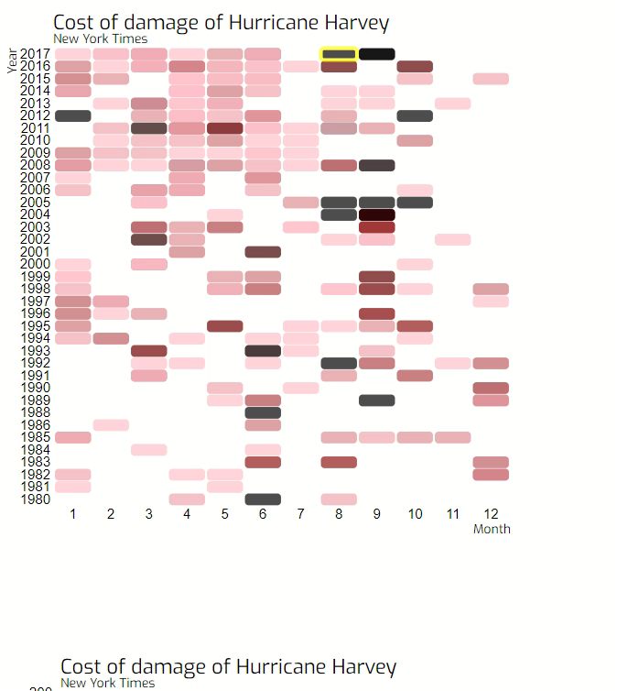
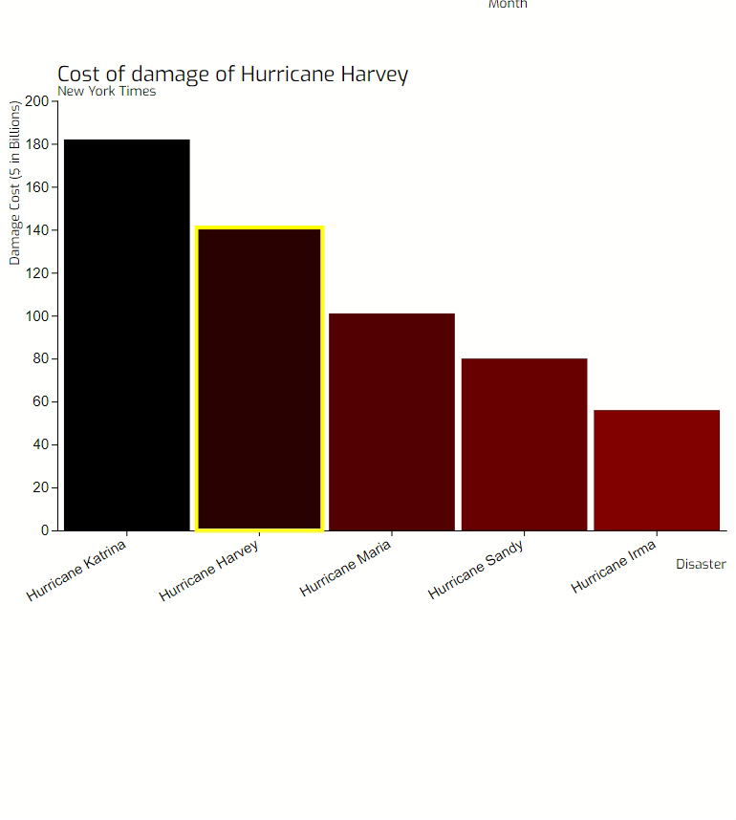
Proposed revision
okiane.github.io/hass-assignment5/
Proposed revision
https://www.ncdc.noaa.gov/billions/events/US/1980-2017

Slide 16
Proposed revision
A heatmap with a linear colour scale (Red Hue from pink to black) to show extent of damage (cost). Pink was used instead of white because white cannot be seen on white background.
Ideally, a colour legend should reflect the scale of damage (Tried to get it up, but it was not displaying).
The Hurricane Harvey is highlighted in yellow to spotlight and allow users to compare with other disasters.
The timing, frequency and distribution of the disaster (Year, Month) can be interpreted based on the positions of the cells.
Users can hover over the cell to view more information in the tooltip. This removes clutter and keeps the user focused on the key information on the cost of damage.
Information on the comparison with the top disaster with the highest cost of damage is shown in the tooltip.
Additional barplots at the bottom) are shown to illustrate the top 5 disasters with highest cost of damage, which is used to compare with the costliest disaster in recent history.
https://www.ncdc.noaa.gov/billions/events/US/1980-2017

Slide 17
Limitations of proposed revision
However, there are limitations for these visualizations:
The heatmap does not show the type of disaster. A possible solution is to colour the border of the cell accordingly to reflect the nature of the event. However, this may make the visualization more cluttered, messy and confusing. The best solution is to facet out the natural disasters (one heatmap for each, and one for overall like this one).
There might be some disasters that occur at the same time that cannot be visualized. Possible solution includes splitting the cell vertically into the 5 slices, each representing one natural disaster (In fact there are 8 from the original source NOAA). However, it may not totally resolve the issue of overlapping events of the same nature.
Linked interactivity between the two charts shown, and a focus slider that slides across a chronologically ordered barchart (x-axis: date of disaster, y-axis: cost of damage) will help users to better navigate through the natural disasters.

